Slide 1
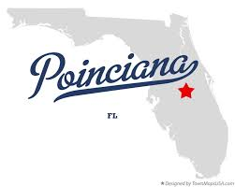
Poinciana Midge Overview
August 20, 2020
John Greene – Clarke

Slide 2
Intro
Objectives
Midge 101
Integrated Pest Management – IPM
Questions
Agenda
Agenda

Slide 3
Introduction

Slide 4
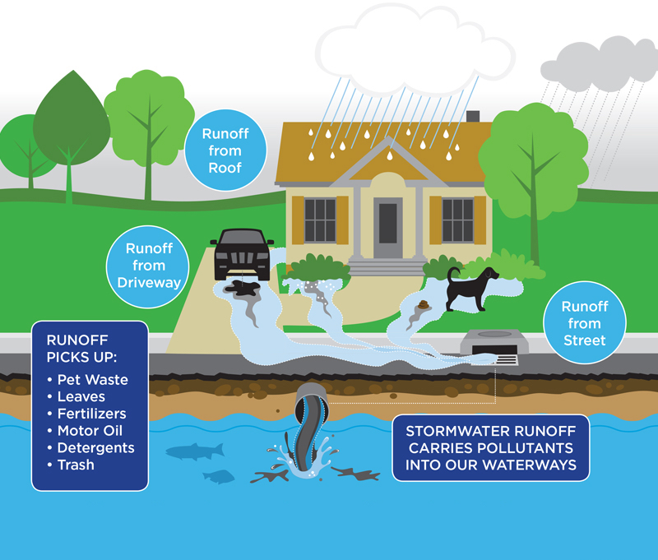
Stormwater Systems
Stormwater systems are tools for managing the runoff from rainfall
Created to provide fill for building pads
Prevent flooding
Remove pollutants
Recharge aquifer
“Contaminants/nutrients, collect over time in a eutrophic/stratified environment. This is not a natural waterbody.” Randy Cross NPBCID

Slide 5
Clarke: Kissimmee, The Villages, Ft Myers and West Palm Beach
Local Experience:
Certified Florida storm-water inspectors
Licensed herbicide applicators – preserves and wetlands
Natural areas management – preserves and wetlands
Public health – mosquito borne disease
Observe, Inform, Options and Plan
Notes:
Intro: Clarke Public health we manage stormwater ponds and systems, formulate and manufacture mosquito control products.
Presidential Green Chemistry award Used on or near organic farms.
John Greene going on 7 years with Clarke …

Slide 6
Midge 101

Slide 7
Adult midges do not bite, suck blood or carry diseases – sometimes called
“Blind Mosquitos”
Larval filter feeders – born without mouth parts
Mate and die
Break reproductive cycle – in ponds and on land
Proliferate in low dissolved oxygen and high in nutrient waters
nitrogen / phosphorus
Agenda
Agenda

Slide 8
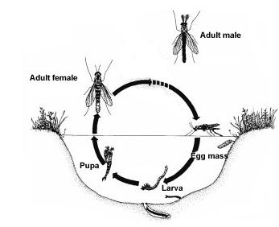
Life Cycle
Complete Metamorphosis
Egg: 2-7 days
Larva: 2-7 weeks
Pupa: 3 days
Adult: 3-5 days
Entire cycle 3-9 weeks
Temperature dependent!!!

Slide 9
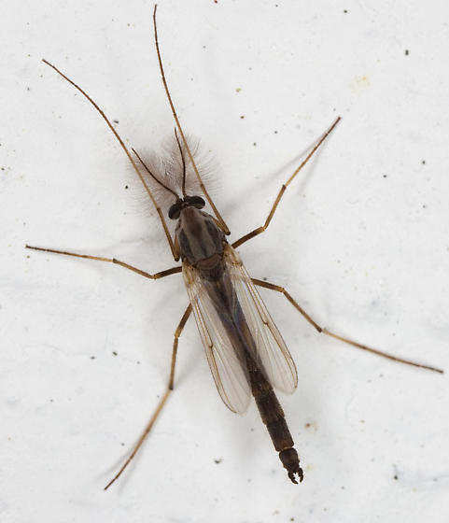
Midge Adults

Slide 10
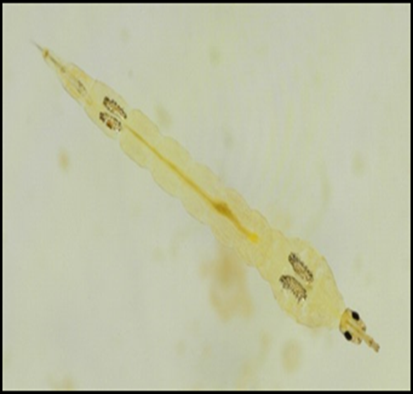
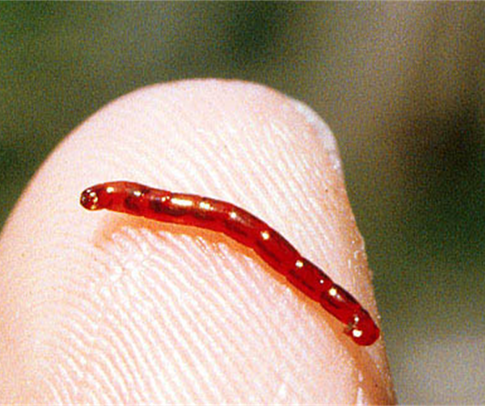
Midge Larvae
Phantom midge - Chaoborid
“deep water”
Edge midge – Chironomid
“Lake and pond edges”
Notes:
Order and family of mosquitos
Phantom- deeper lower oxygen reproduce in mucky pond bottoms with high organic content
Edge midge – sandy bottoms along the edge of lakes and ponds
Filter feeders

Slide 11
Home Owner Challenges:
Swarming creates nuisance problems, interfering with outdoor, activities.
Homes, screens, vegetation and lighting.
Attract spider webs
Soiling-staining homes - structures
“Fishy” odor of dead adults

Slide 12
Integrated Pest Management IPM

Slide 13
Clarke Midge IPM
Nutrient Abatement
Florida-Friendly Landscaping™ principles
Grass clipping disposal
Aeration
Littoral Planting
Biological Control:
Fish Stocking
Fall: Bream (70% blue gill / 30% red ear)
Spring: Bass
Gambusia: “Mosquitofish”

Slide 14
Clarke Midge IPM
Chemical Treatments
Proactive Larval Control | Reactive Adulticiding
Lake Treatments | Barrier
Area-wide | ULV

Slide 15
Today’s Takeaways
Stormwater systems are non-natural aquatic systems
Water quality affects midge populations
Suppression over eradication
Planning 1, 3, 5 years
Combination of tools-techniques
Break the reproductive cycle

Slide 17
THANK YOU
John A. Greene
jgreene@clarke.com
561-632-5712

